Slide 1
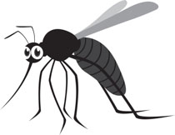
Predicting West Nile Virus Outbreaks in Chicago
By
David Ross

Slide 2

Business Problem
West Nile virus (WNV):
Transmitted to humans via infected mosquitoes
Potentially fatal
Known presence in Chicago area
Goals:
Predict when, and where, mosquitoes will be WNV positive
Identify explanatory factors for WNV presence

Slide 3

Data Collection
Mosquito traps throughout Chicago (location, mosquito count, species, WNV presence)
Chicago weather data:
Chicago O’Hare International Airport weather station
Chicago Midway International Airport weather station
Mosquito spray data (spray data and location)
Data source: https://www.kaggle.com/c/predict-west-nile-virus

Slide 4
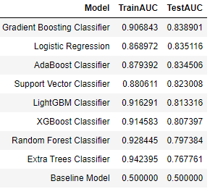
Model Selection
Tested 8 different models (excluding baseline)
Baseline model: uniform random predictor
Evaluated models using AUC-ROC Curve (AUC)
Best Model: Gradient Boosting Classifier

Slide 5
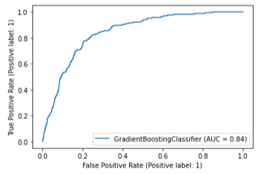
Final Model – Gradient Boosting Classifier
Hyperparameter tuning further improved performance
Final AUC Score: 0.8425

Slide 6
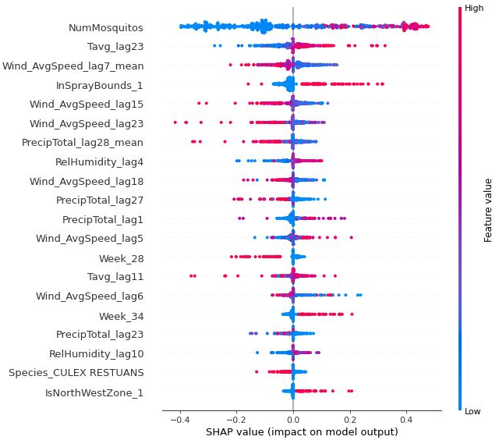
Explanatory Factors for WNV (1)
Top 5 Predictors for WNV Presence:
High number of mosquitoes
High average daily temperature with a 23-day lag
Low mean wind speeds from 7-14 days prior
Trap is located within spray boundaries
Low average wind speed with a 15-day lag

Slide 7
Explanatory Factors for WNV (2)
Other WNV Predictors:
23-day lag period was important
High relative humidity
Culex Pipiens species
Location identified as “Northwest Zone”
Seasonality:
Week 28 (low WNV)
Week 34 (high WNV)
Precipitation had a varied effect

Slide 8
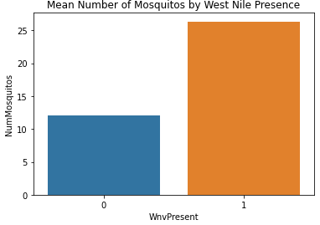
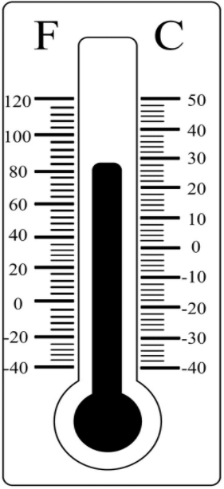
Conclusions (1)
Mosquitoes:
↑ trapped mosquito count = greater WNV likelihood
Culex Pipiens = greater WNV likelihood
Weather/Climate:
↑ temperature, ↑ humidity, ↓ wind speed = optimal breeding conditions
Chicago climate = 23-day mosquito lifecycle

Slide 9
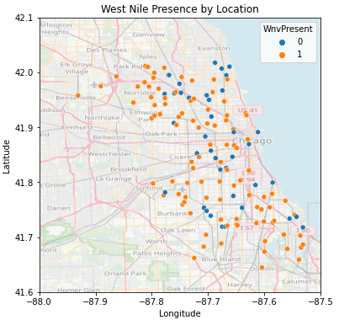
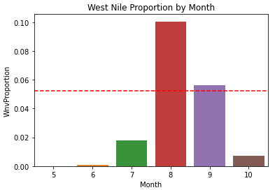
Conclusions (2)
Location:
High risk in Northwest Zone
Seasonality:
Risk is greatest around Week 34 (mid-late August )

Slide 10
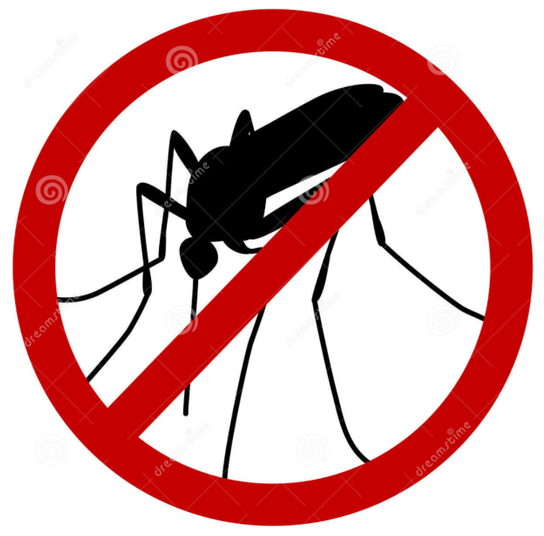
Recommendations
How to utilize improved predictive capabilities:
Preventative mosquito spraying
Increase public awareness: when/where risk will be high

Slide 11

Potential Future Actions
Analyze bird populations (species, migration, habitat, WNV presence)
Chicago geography/terrain data may provide finer grained understanding of mosquito habitats
Checking mosquito traps daily may improve data quality
Analyze impacts of proactive spraying
Analyze annual weather (rather than May-October)
Research and collect data on additional factors impacting mosquito populations

Slide 12
References
Mosquito image (title page): https://classroomclipart.com/clipart-search/mosquito/
Magnifying glass image (data collection page): https://clipart.world/magnifying-glass-clipart/animated-magnifying-glass-clipart-transparent/
Question mark image (business problem page): https://www.presentermedia.com/powerpoint-clipart/stickman-question-mark-thinking-pc-pid-1680
West Nile Virus details (business problem page): https://www.kaggle.com/c/predict-west-nile-virus
Thermometer image (conclusions page 1): https://clipart.world/thermometer-clipart/weather-thermometer-clipart-black-and-white-1/
Anti-mosquito image (Recommendations page): https://www.dreamstime.com/stock-illustration-no-mosquito-sign-stop-sign-isolated-white-image44573804
“What’s Next” image (Potential Future Actions page): https://www.istockphoto.com/vector/whats-next-gm1027886480-275568145

